Slide 1
Containerized CRUD Web Application Deployment using Docker and Kubernetes
Library Management System Presented by: Aman Raj
Date: 27th February

Slide 2
Introduction to Library Management System
A Library Management System (LMS) is software that automates and manages the daily activities of a library. It helps maintain records of books, members, book issues, returns, and fines in an organized and efficient way. The system reduces manual work, saves time, improves accuracy, and makes it easier to search, track, and manage library resources. Overall, it enhances the smooth functioning of library operations and provides better service to users.

Slide 3
Problem Statement
Manual library management is error‑prone and time‑consuming.
Tracking book availability, member borrowing, and overdue fines manually is inefficient
Goal: Build a digital system that:
Automates book and member management.
Tracks borrowing history with due dates.
Calculates fines automatically.
Is scalable, portable, and production‑ready.

Slide 4
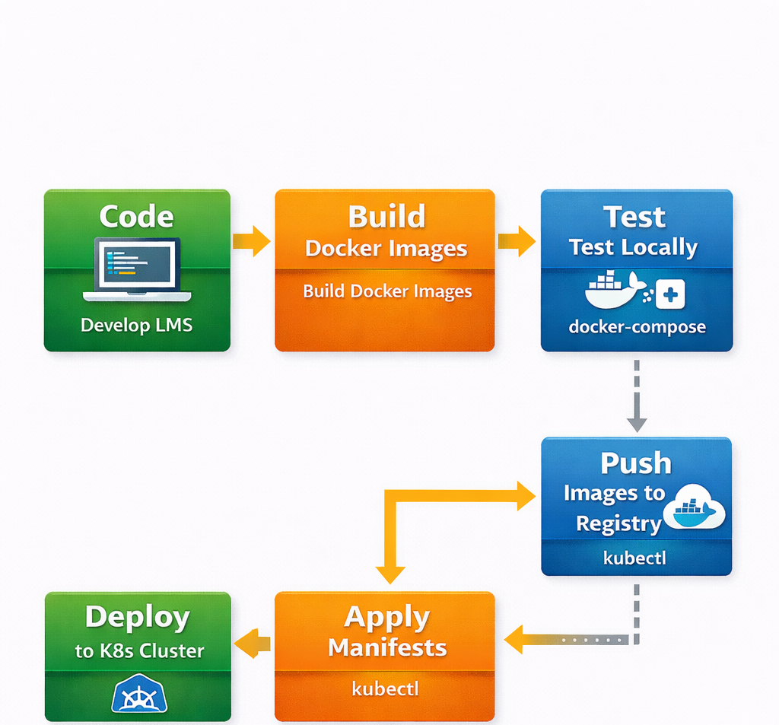
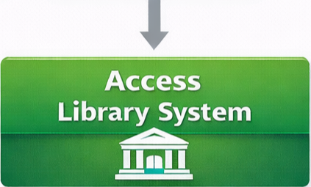
Complete Deployment Workflow

Slide 5
Features at a Glance
Books: Add, edit, delete, view available copies.
Members: Register students with unique ID, email, phone.
Borrow/Return: Issue books with due date, auto‑calculate fine (₹0.50/day).
Fine Management: Pay fines, track paid status
Persistent Storage: MongoDB with data volume.
Containerized: Docker for consistent environment.
Orchestrated: Kubernetes for scalability and self‑healing.

Slide 6
Technology Stack
I chose a modern stack that balances simplicity with power:
Frontend: Pure HTML, CSS, and JavaScript – no frameworks, which keeps it lightweight and fast, and demonstrates that I can work with core web technologies.
Backend: Node.js with Express – provides a robust RESTful API layer.
Database: MongoDB – a NoSQL database that stores data as flexible JSON documents, perfect for the varied structure of books, members, and borrow records. I used Mongoose as an ODM for schema validation and data modeling.
Containerization: Docker – to package the application and its dependencies into isolated containers, ensuring consistent behavior across environments.
Orchestration: Kubernetes – specifically, the built‑in Kubernetes in Docker Desktop. This allows me to deploy, scale, and manage the containers, providing self‑healing, load balancing, and persistent storage.

Slide 7
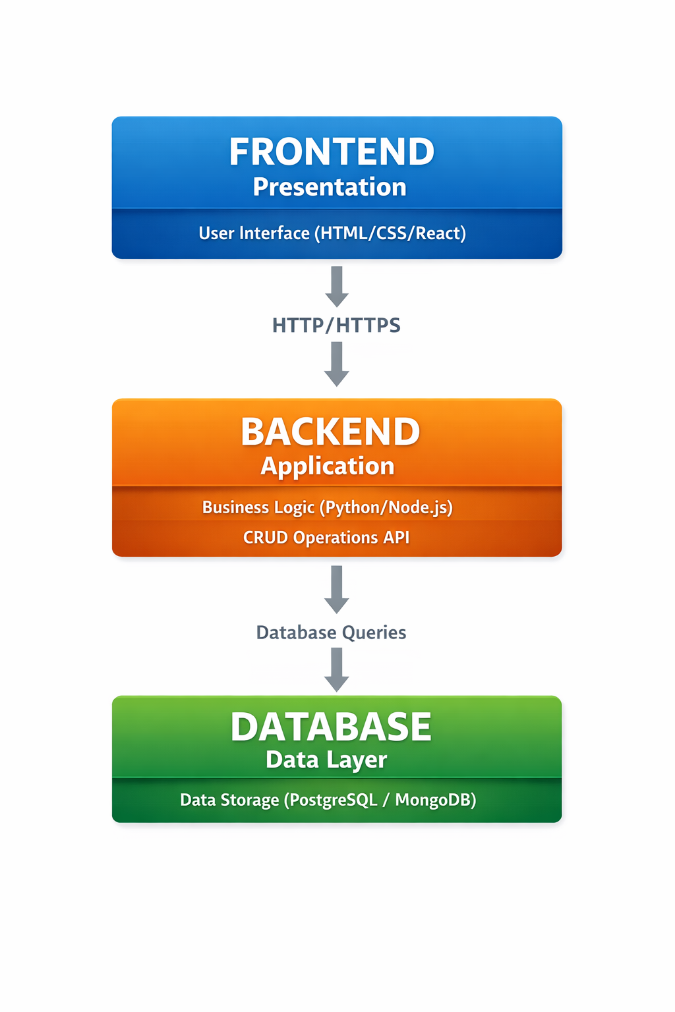
System Architecture
User’s Browser – serves the static frontend files (HTML, CSS, JS) from the backend.
Backend Service (Node.js) – exposes REST endpoints that the frontend calls. It handles business logic, such as validating inputs, updating book availability, and calculating fines.
MongoDB Database – stores all persistent data. The backend communicates with it using Mongoose.

Slide 8
Challenges and Solutions
Data persistence in Kubernetes:
Without a Persistent Volume Claim, MongoDB would lose all data when the pod restarts. Adding a PVC solved that, and Kubernetes binds it to a persistent volume automatically (in Docker Desktop, it uses a local host path).
Fine calculation across time zones:
Date comparisons can be tricky. I ensured all dates are stored and compared in UTC by using JavaScript’s Date objects and performing calculations on milliseconds. Converting to days with Math.ceil handles partial days correctly.
Connecting backend to MongoDB inside containers
Initially, the backend couldn’t connect because it was looking for localhost. The solution was to use the service name mongodb as the hostname in the connection string, which works because Docker Compose and Kubernetes both provide internal DNS resolution.

Slide 9
Future Enhancements
Search & Filter – find books/members quickly
Authentication & Authorization – librarian login.
Email Notifications – reminders for due dates.
Barcode/QR Code Scanning – faster check‑in/out.
Analytics Dashboard – most borrowed books, fines collected

Slide 10
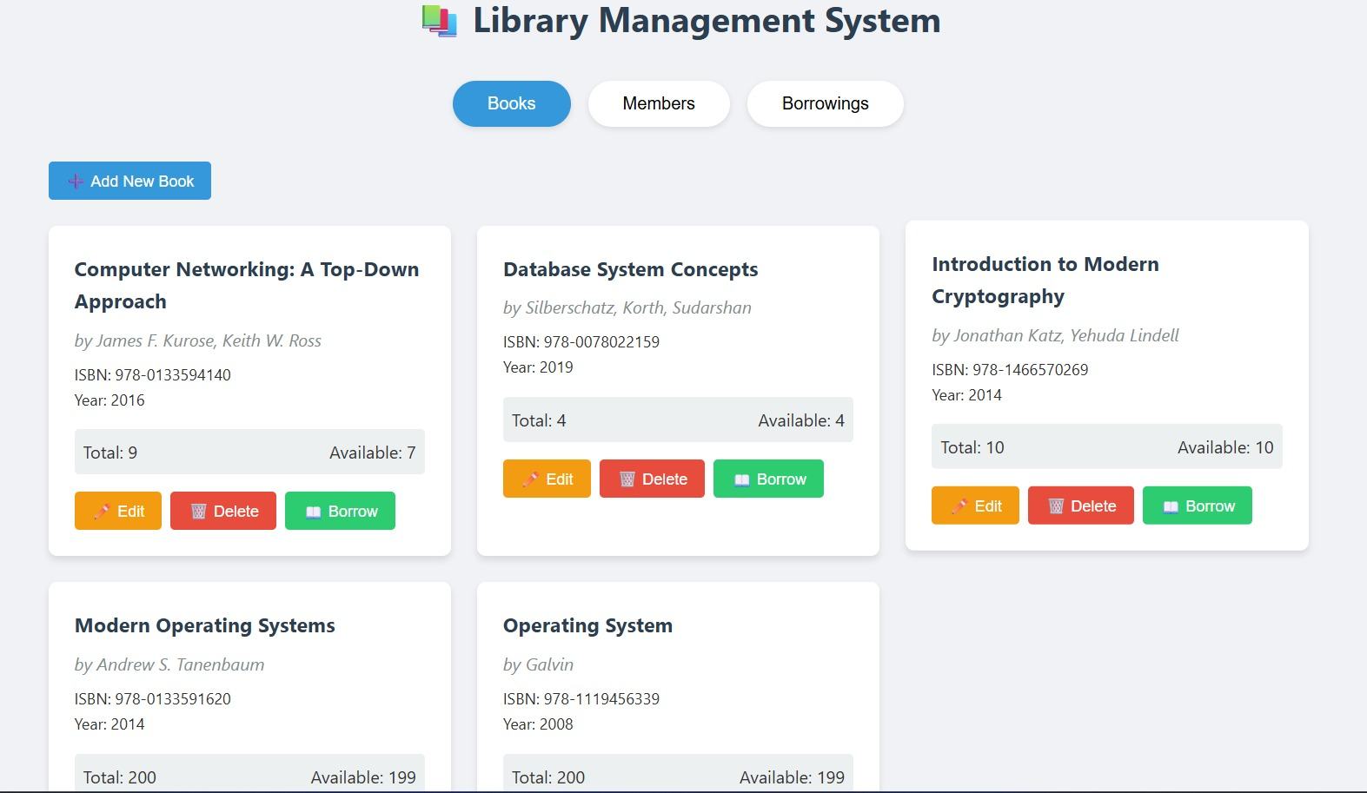

Slide 11
Conclusion
Successfully built a full‑stack library management system.
Implemented core features: CRUD, borrowing, fine calculation.
Containerized with Docker for portability.
Deployed on Kubernetes for scalability and resilience.
Demonstrates proficiency in modern DevOps practices.

Slide 12
Thank you!

